Slide 1

How to Foster
Positive Communication
Rizwan Anver
Jubal Johnson
Jomon Joy
Notes:
Hsbhdjjsj

Slide 2
Table of Contents
Benefits of Positive Communication
Establishing Positive Communication
Effective Listening

Slide 3

Benefits of Positive Communication
Strengthens relationships
Supports emotional well-being
Reduces physical stress
Supports career growth
Improves Intellectual development
Promotes cultural understanding

Slide 4

Relational
Well-being
Communication = good relations
Relationships connect humans together

Slide 5
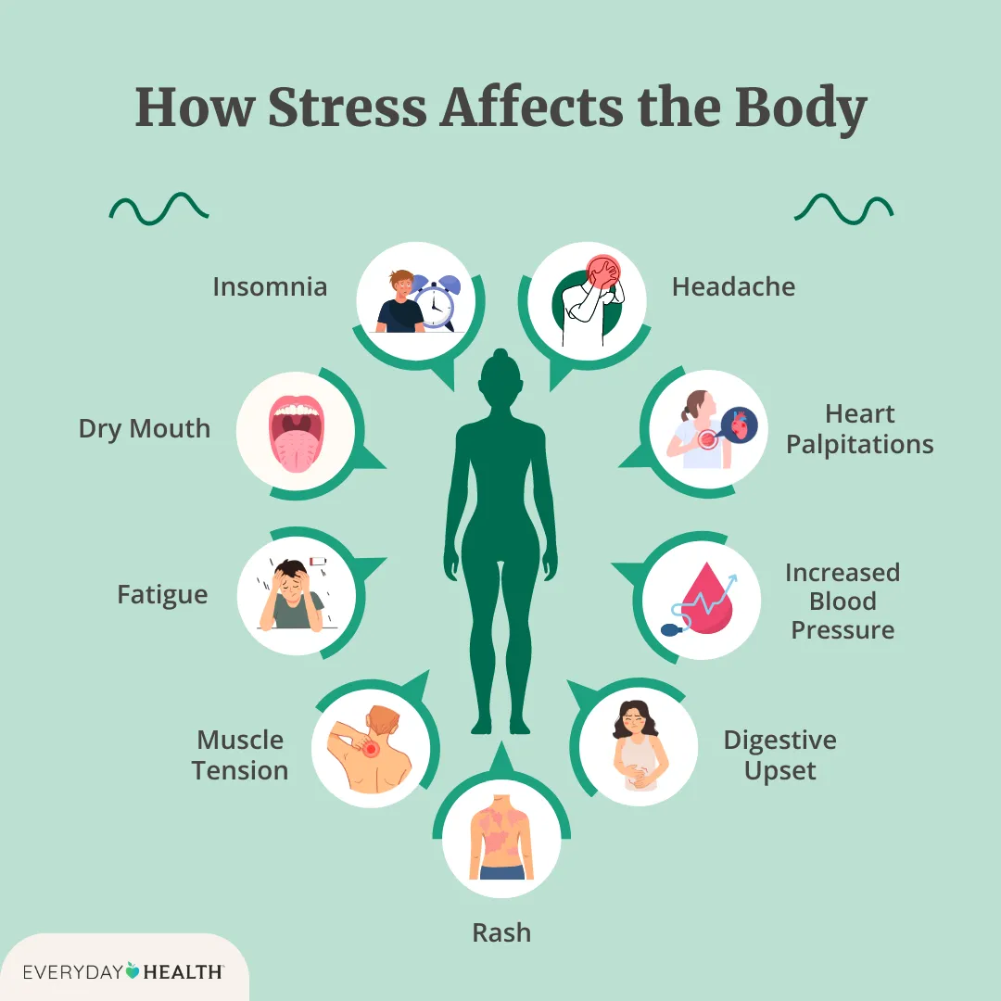
Emotional & Physical Well-being
Expressing emotions
Relieving mental stress
Addressing Physical Stress Symptoms
[1]

Slide 6

Career & Intellectual Well-being
Boosts interview skills
Enhances career growth
Encourages discussions
Develops strong EQ(Emotional Quotient)

Slide 7

Cultural Well-being
The ability to converse diversly
Helps create unity

Slide 8
Establishing Positive Communication
Language (profanity, articulation etc..)
Body Language
Tone
Use of specific terminology (Race, gender, politics)
Being proactive (Openly communication, regardless of feelings)

Slide 9

Effective Listening
Good Questions
Forming Questions ( starting questions with "why")
Attentive Listening
Asserting Patience (Let the person speak/finish)

Slide 10

Conclusion
Communication morphs (relationships)
Benefits of Communication
Reflective listening (huge role)

Slide 11
References
[1] P. Derrow, “The Most Common Symptoms of Stress, and how They Affect You in the Short and Long Term,” Everyday Health, Mar. 4, 2024. [Online]. Available: The Most Common Symptoms of Stress. March 4, 2024 [Mar. 9, 2026].

